Slide 1
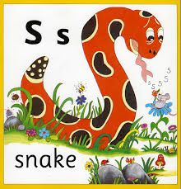
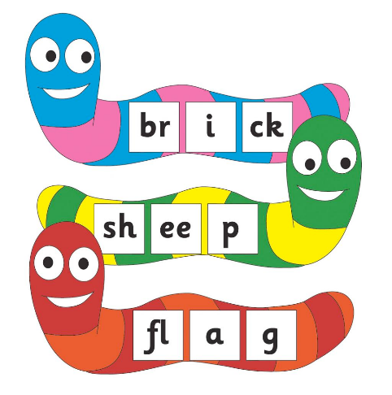
Year 1 Phonic
Parent Workshop
Miss J Cox 2021

Slide 2
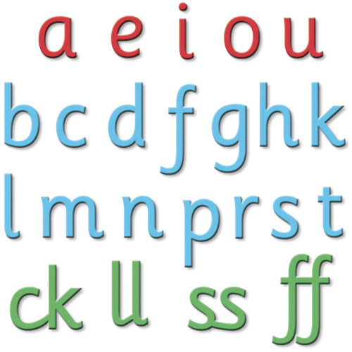
Aims
1) Book bags - Word/sound cards in wallet
library books
Reading books
Word/spelling/sound cards (CT/LSA)
2) What is phonics? Phonic vocabulary
3) How to read, blend and segment key words
4) Alien words – What are they for?
5) Resources to support at home

Slide 3
Year 1 structure
Week 1 CT - words/sounds/spelling
LSA –reading colour banded book
Week 2 LSA - words/sounds/spelling
CT – reading colour banded book
Second Term - LSA words/sounds/spelling
CT – guided reading
Mixture – colour reading banded book
Phonics – Two daily sessions with CT

Slide 4
Phonics is simply the code that turns written language into spoken language and vice versa. It is the vital initial step in teaching children to read but it is far from the whole picture. Phonics will only work in an environment where Speaking and Listening Skills are promoted and developed. Children should also be regularly exposed to a wide range of quality texts. They should be regularly read aloud to. Regular, well planned Guided Reading sessions are essential and reading skills should also be explicitly taught in Shared Reading sessions within literacy lessons.

Slide 5
Phonic Vocabulary
Phoneme - The smallest unit of sound. There are approximately 44 phonemes in English (it depends on different accents). Phonemes can be put together to make words.
Grapheme - A way of writing down a phoneme. Graphemes can be made up from 1 letter e.g. p, 2 letters e.g. sh, 3 letters e.g. tch or 4 letters e.g ough.
GPC - This is short for Grapheme Phoneme Correspondence. Knowing a GPC means being able to match a phoneme to a grapheme and vice versa.
Digraph - A grapheme containing two letters that makes just one sound (phoneme).
Trigraph - A grapheme containing three letters that makes just one sound (phoneme).
c a t - cat
sh/ch/ng
igh/ear/air

Slide 6
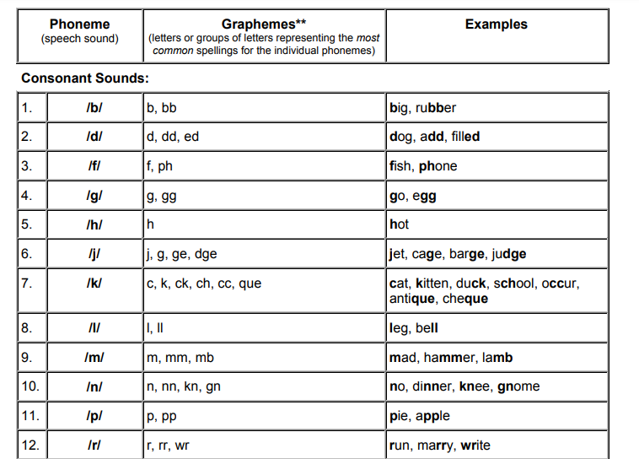

Slide 7
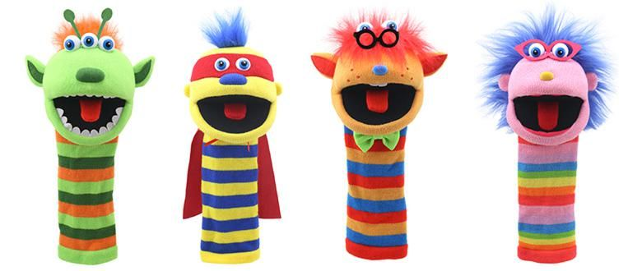
Blending
Oral Blending - This involves hearing phonemes and being able to merge them together to make a word. Children need to develop this skill before they will be able to blend written words.
Blending- This involves looking at a written word, looking at each grapheme and using knowledge of GPCs to work out which phoneme each grapheme represents and then merging these phonemes together to make a word. This is the basis of reading.
ch a t
ch e ss
ch i m p

Slide 8
Segmenting
Oral Segmenting - This is the act of hearing a whole word and then splitting it up into the phonemes that make it. Children need to develop this skill before they will be able to segment words to spell them.
Segmenting - This involves hearing a word, splitting it up into the phonemes that make it, using knowledge of GPCs to work out which graphemes represent those phonemes and then writing those graphemes down in the right order. This is the basis of spelling.
shell
shed
shrimp

Slide 9
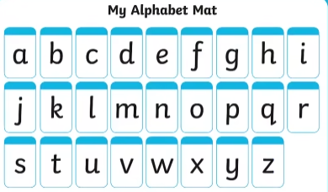
s a t p i n m d g o c k ck e u r h b f ff l ll ss j v w x y z zz

Slide 10
s a t p i n m d
g o c k ck e u r

Slide 11
Phase 1
Phase 1 is absolutely vital. It is the one phase that shouldn't come to an end. These skills should continue to be developed throughout KS1 and KS2. Phase 1 develops children's abilities to listen to, make, explore and talk about sounds. This phase is split into 7 aspects that are explored and developed through games.
Aspect 1 - Environmental Sound Discrimination.
Aspect 2 - Instrumental Sound Discrimination.
Aspect 3 - Body Percussion Sound Discrimination.
Aspect 4 - Rhythm and Rhyme.
Aspect 5 - Alliteration.
Aspect 6 - Voice Sounds.
Aspect 7 - Oral Blending and Segmenting.

Slide 12
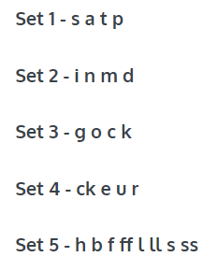
Phase 2
It is very important that you pronounce these phonemes clearly and correctly. If you don't, children may find it very difficult to blend them together.
When we introduce GPCs, we ensure that we introduce them with the sounds, pictures, actions and lots of practise for forming the letter. You can form the letter with a finger in the air, on the palm of the hand, on the back of another child, on a rough surface like the floor. All these experiences will need to come before trying to write the letter on a whiteboard or piece of paper.

Slide 14
Phase 3
Phase 3 continues in the same way as Phase 2 and introduces more new GPCs. By the end of Phase 3 the children will know one way of writing down each of the 44 phonemes.
Make sure that you are confident about what the term CVC means. It refers to words with a consonant phoneme, a vowel phoneme and then a consonant phoneme - it is not referring to letters. Therefore hot, bed, boat and ship are all CVC words but cow and toy are not.

Slide 16
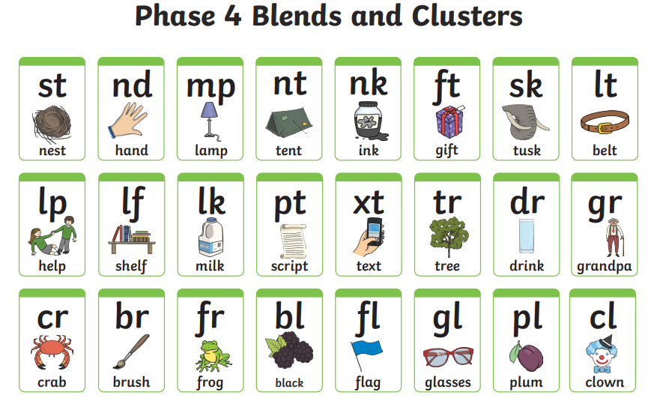
Phase 4
The main challenge in this phase is to help children to blend and segment words with adjacent consonants e.g. truck, help. These adjacent consonant phonemes can both be heard when you say the word which makes them different from a digraph where there are two letters that make just one sound. Be careful, lots of people get these confused, including some published materials.
Children with speech and language difficulties can find Phase 4 very tricky. If children struggle to hear all the sounds in a word encourage them to think about the movements that their mouths are making. Looking in mirrors can help with this.

Slide 17
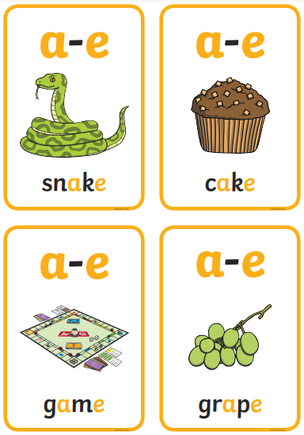
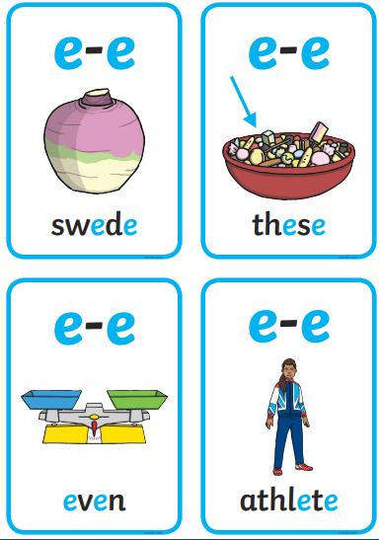
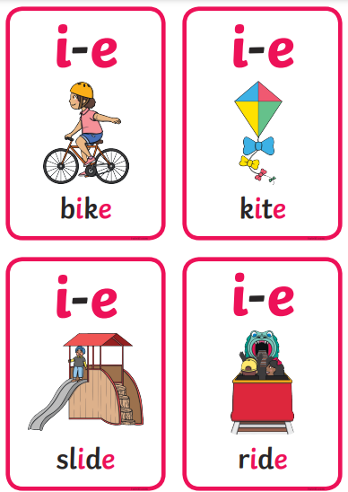
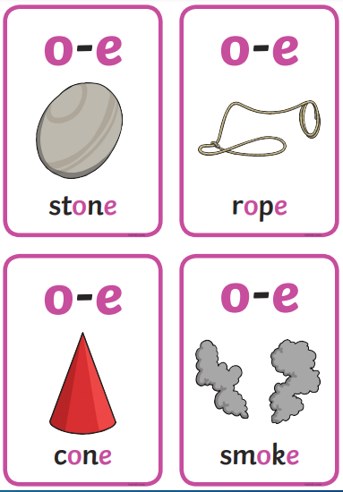
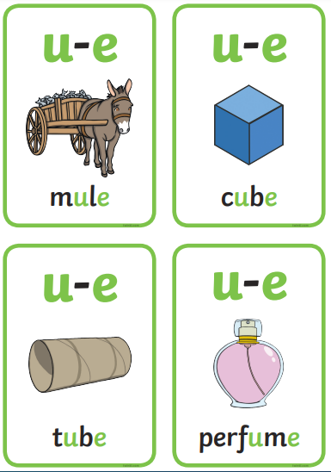
Phase 5a
These 4 weeks introduce some new GPCs in the same way as in previous phases. Five of these GPCs are known as split digraphs. They are a_e, e_e, i_e, o_e, u_e. These used to be taught as magic e but now it is recommended that children learn to recognise these in the same way as other graphemes but simply explaining that in these particular graphemes the two letters work as a team but they aren't directly next to each other.

Slide 18
Phase 5b
These 3 weeks introduce the idea that some graphemes can be pronounced in more than one way. E.g. the ch grapheme can be pronounced in each of these ways check, chef and school. This is a vital lesson for children to learn and they need to learn to apply it in their reading.
We model trying to read a word by sounding out the most obvious phonemes then blending it together. If it doesn't make sense, model looking at each grapheme and seeing whether there are alternative pronunciations. Try sounding out the word with the alternative pronunciation and blending it together. Does it make sense now? This can be quite a jump for some children to make as they have to realise that English isn't quite as straightforward as it once seemed. However, it can also be quite empowering to know that just because a word doesn't make sense first time, it doesn't mean that they can't go back and figure it out for themselves.

Slide 19
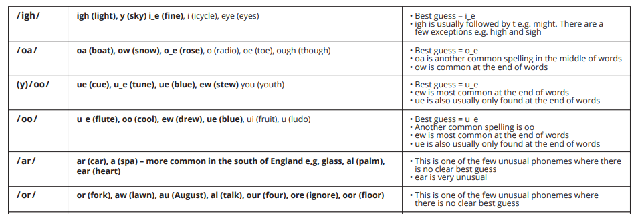
Phase 5c
This part of Phase 5 is all about learning that some phonemes have more than one spelling (in fact some of the really awkward ones have loads of different spellings).

Slide 20
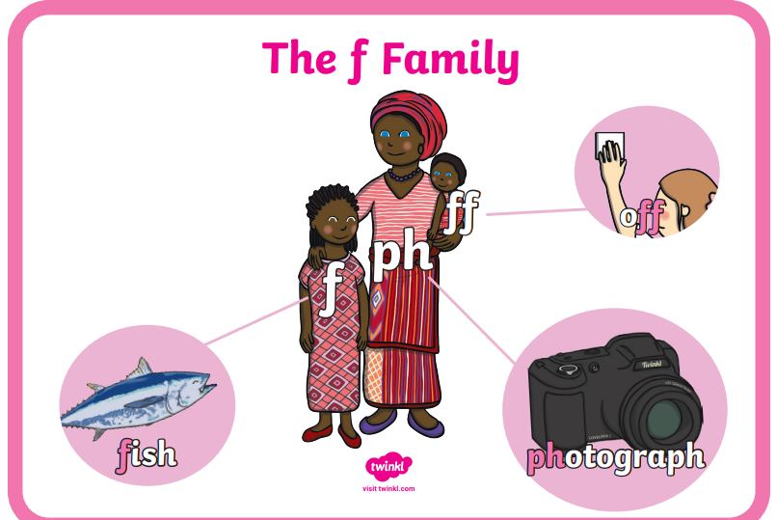
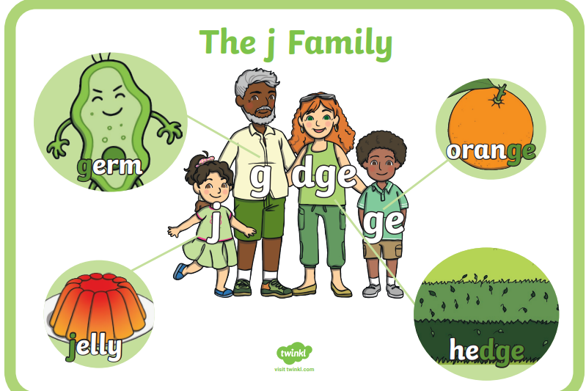
Phase 6
Phase 6 reinforces much of the learning from Phase 5, helps children to develop greater automaticity in reading, and begins to explore spelling rules and conventions e.g. adding -ing and -ed.

Slide 21
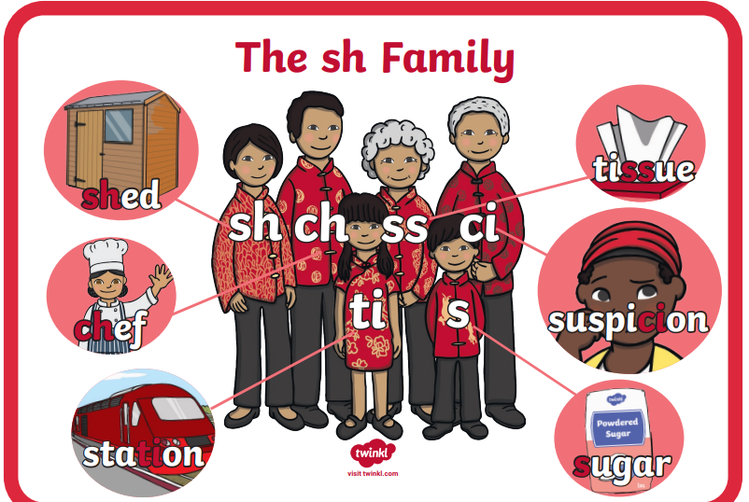
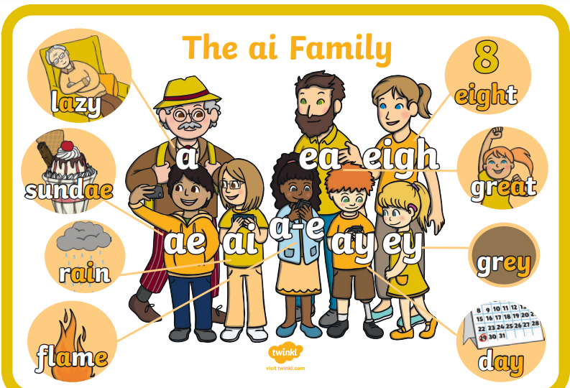

Slide 22
Revisit and review
Teach (Introduce new sound)
Practice
Apply
Video clip

Slide 23
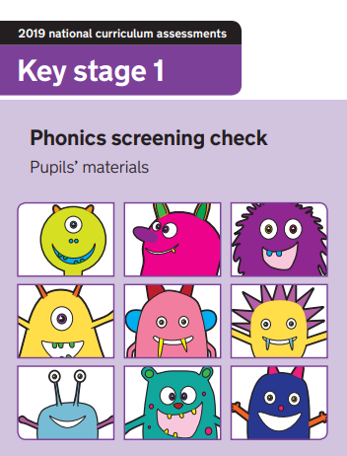
The phonics screening check is taken individually by all children in Year 1 in England, and is usually taken in June. It is designed to give teachers and parents information on how a child is progressing in phonics. It will help to identify whether a child needs additional support at this stage so that they do not fall behind in this vital early reading skill.
There are two sections in this 40-word check and it assesses phonics skills and knowledge learned through Reception and Year 1. Your child will read up to four words per page for their teacher and they will probably do the check in one sitting of about 5–10 minutes.

Slide 24
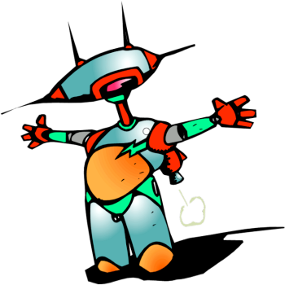
These are words that are phonically decodable but are not actual words with an associated meaning e.g. brip, snorb.
Pseudo words are included in the check specifically to assess whether your child can decode a word using phonics skills and not their memory.
The pseudo words will be shown to your child with a picture of a monster and they will be asked to tell their teacher what sort of monster it is by reading the word. This not only makes the check a bit more fun, but provides the children with a context for the nonsense word which is independent from any existing vocabulary they may have. Crucially, it does not provide any clues, so your child just has to be able to decode it. Children generally find nonsense words amusing so they will probably enjoy reading these words.
sath
geth

Slide 25
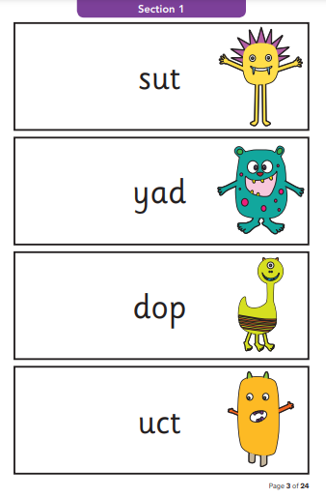
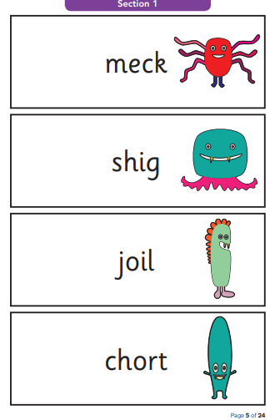
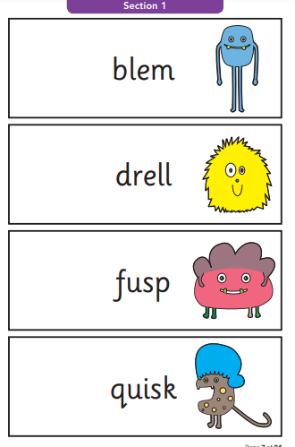

Slide 26
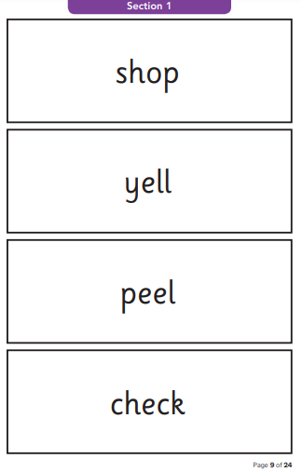
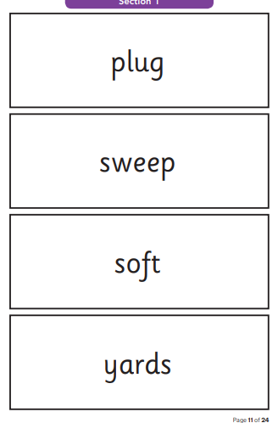
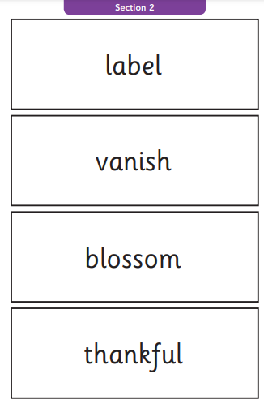

Slide 27
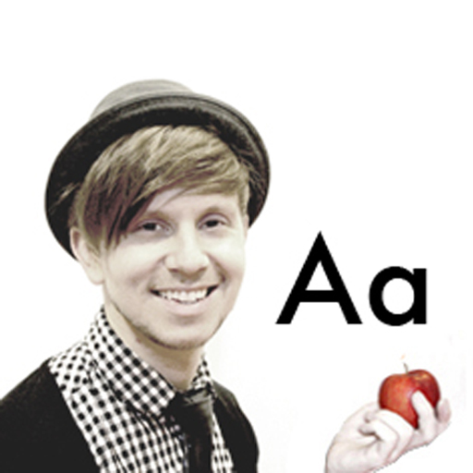
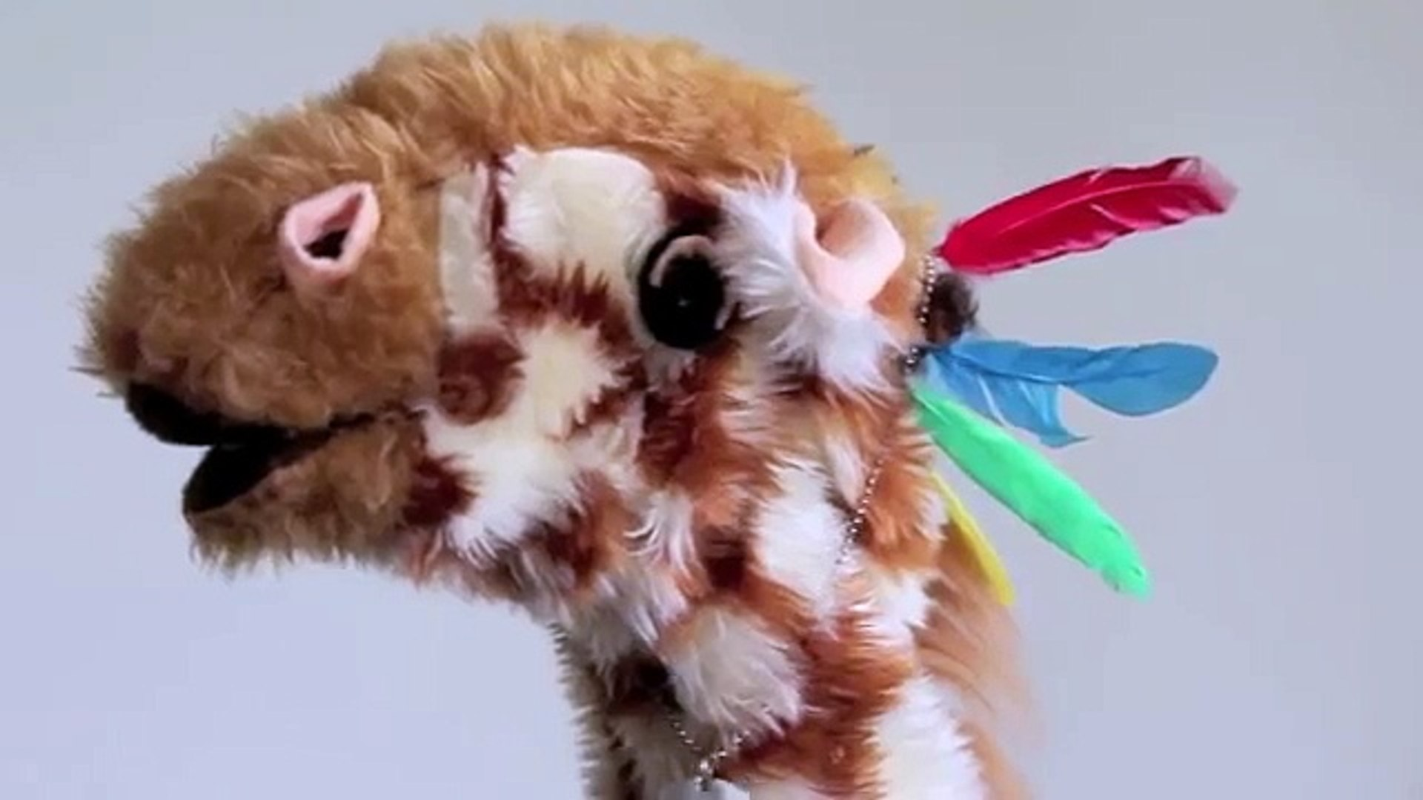
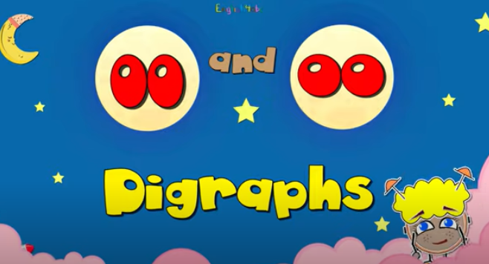
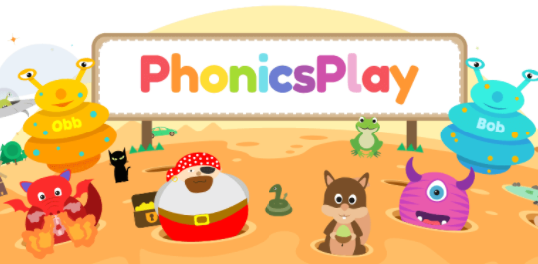

Slide 28
https://www.youtube.com/watch?v=IwJx1NSineE
http://www.youtube.comwatchv=eCjJYB07aSU&feature=related
Mr Thorne does phonics
http://www.letters-and-sounds.com
http://www.bbc.co.uk/cbeebies/grownups/programme-extra/alphablocks-guide-to-letters-and-sounds
http://www.phonicsplay.co.uk/Phase5Menu.htm
http://jollylearning.co.uk/gallery/

